Slide 1
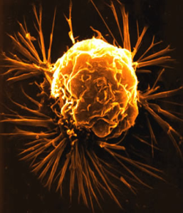
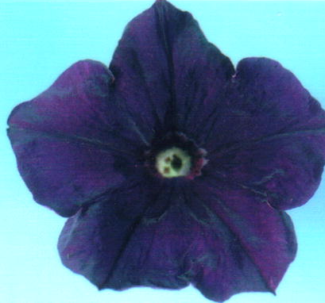

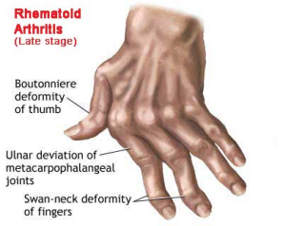
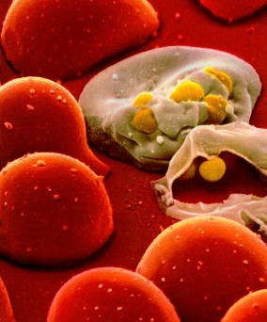

How Genes are Controlled
Lecture 18
Dr. Chandra Emani

Slide 2
What Are We Going to Learn Today?
How are genes expressed in life forms?
At what levels are genes controlled?
What is an OPERON?
What is RNAi and miRNA?

Slide 3
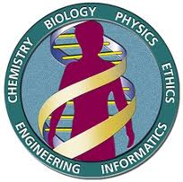
Human Genes
The human genome contains ~ 30,000 genes
A given cell “expresses” (transcribes) only a small number of genes
Some genes are expressed in all cells
Other genes are expressed only
  In certain types of cells
  At certain times in an organism’s life
  Under specific environmental conditions

Slide 4
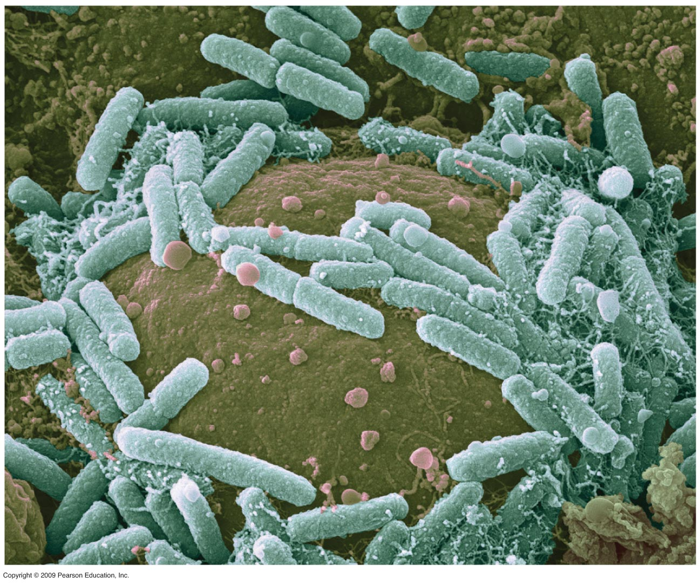
Proteins interacting with DNA turn prokaryotic genes on or off in response to environmental changes
0
  Gene expression is the overall process of information flow from genes to proteins
    Mainly controlled at the level of transcription
    A gene that is “turned on” is being transcribed to produce mRNA that is translated to make its corresponding protein
    Organisms respond to environmental changes by controlling gene expression
Notes:
Student Misconceptions and Concerns
1. The broad concept of selective reading of the genetic code associated with differentiation and types of cellular activity can be missed when concentrating on the extensive details of regulation. Analogies, noted below in the teaching tips, can help students relate this overall selective process to their own experiences. Students already understand the selective reading of relevant chapters in textbooks and the selective referencing of software manuals to get answers to different questions. These experiences are similar in many ways to the broad processes of gene regulation.
2. The many levels of gene regulation in eukaryotic cells can be confusing and frustrating. The water pipe analogy depicted in Figure 11.9 can be a helpful reference to organize the potential sites of regulation.
Teaching Tips
1. The lactose operon is turned on by removing the repressor . . . a sort of double negative. Students might enjoy various analogies to other situations, including the familiar refrain “When the cat's away, the mice will play.” In another analogy, if Mom keeps the kids away from the cookies, but somebody occupies her attention, kids can sneak by and snatch some cookies. In this analogy, the person occupying Mom’s attention functions most like lactose binding to the repressor.
2. A key advantage of an operon system is the ability to turn off or on a set of genes with a single “switch.” You can demonstrate this relationship in your classroom by turning off or on a set of lights with a single switch.
3. The control of gene expression is analogous to buying a book about how to build birdhouses and reading only the plans needed to build one particular model. Although the book contains directions to build many different birdhouses, you read and follow only the directions for the particular birdhouse you choose to build. The pages and directions for the other birdhouses remain intact. When cells differentiate, they read, or express, only the genes that are needed in that particular cell type.

Slide 5
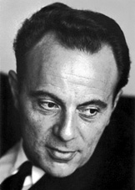
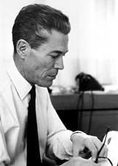
Gene Regulation in Prokaryotes
Prokaryotic DNA is organized into units called operons, which contain functionally related genes
Francois Jacob
French Biochemist
Nobel 1965
Jacques Monod
French Biochemist
Nobel 1965

Slide 6
The Operon Concept
Each OPERON consists of
  A regulatory gene, which controls the transcription of other genes
  A promoter, which RNA polymerase recognizes as the place to start transcribing
  An operator, which governs access of RNA polymerase to the promoter
  The structural genes, which encode for related proteins

Slide 7
The Operon
Whole operons are regulated as units, so that functionally related proteins are synthesized simultaneously when the need arises
A model example is the Lactose Operon or the Lac Operon in E. coli bacterium

Slide 8
Lac Operon
The intestinal bacterium Escherichia coli (E.coli) lives on what its host eats
Specific enzymes are needed to metabolize the type of food that comes along. e.g. in newborn mammals, E.coli are bathed in milk, containing the milk sugar lactose
The lactose operon contains three structural genes, each coding for an enzyme that aids in lactose metabolism

Slide 9
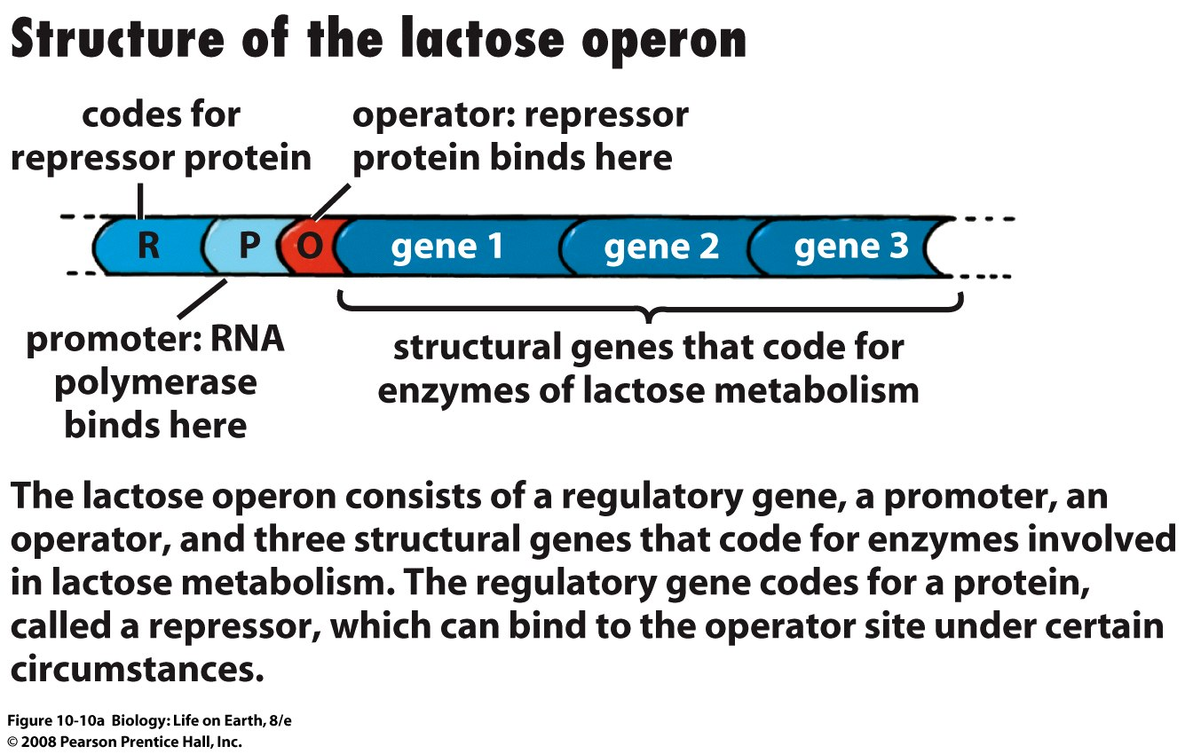
Notes:
FIGURE 10-10a Regulation of the lactose operon

Slide 10
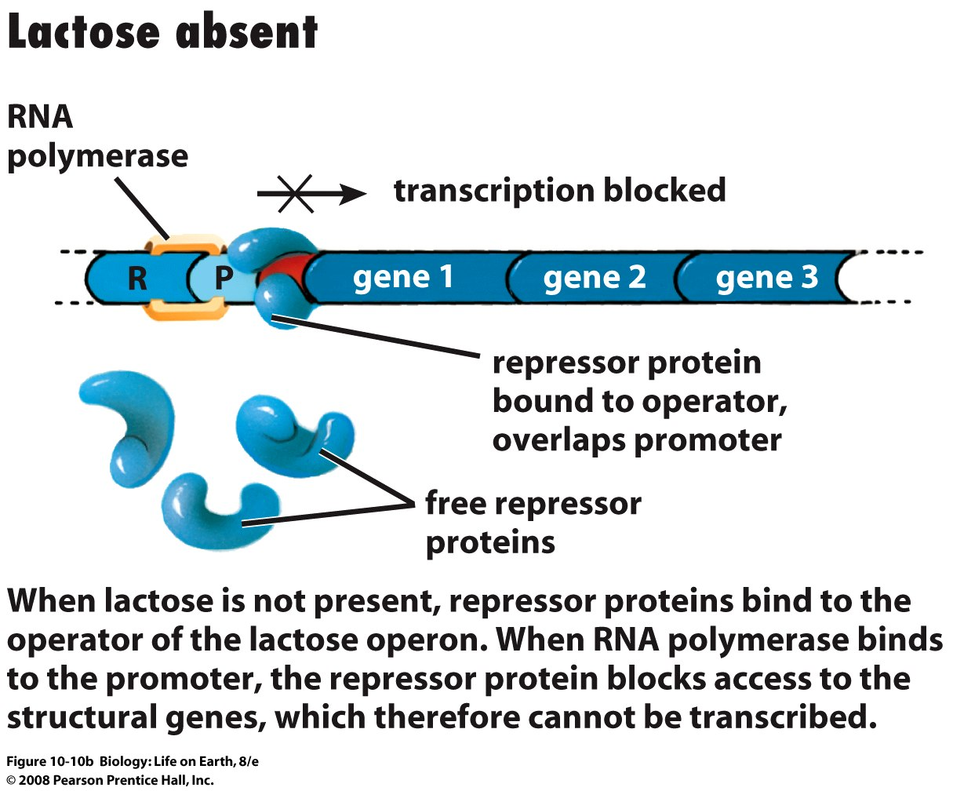
Notes:
FIGURE 10-10b Regulation of the lactose operon

Slide 11
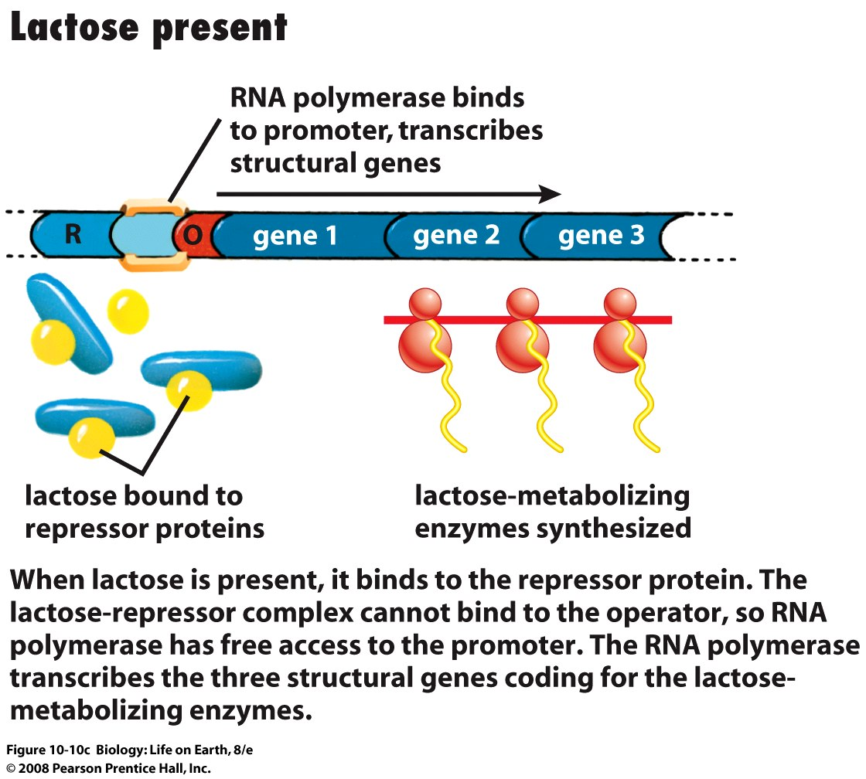
Notes:
FIGURE 10-10c Regulation of the lactose operon

Slide 12
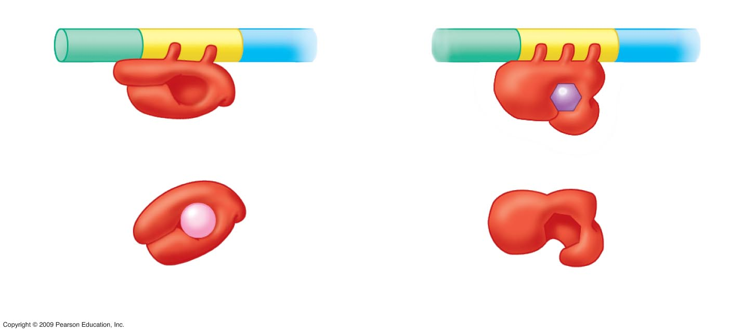
0
Inducible Operon
Repressible Operon
Promoter
Operator
Gene
DNA
Active
repressor
Active
repressor
Tryptophan
Inactive
repressor
Inactive
repressor
Lactose
lac operon
trp operon
Notes:
Figure 11.1C Two types of repressor-controlled operons.
This figure contrasts the control of the tryptophan (trp) operon with the lac operon. The trp operon is repressible, usually turned on unless an active repressor is available to switch it off. When first produced, the trp repressor is inactive so that it does not block transcription of the tryptophan-producing enzymes of the operon. As a result, tryptophan is generally produced by the cell. But if tryptophan is available in the environment, it is energetically efficient for the cell to use the externally supplied amino acid. Tryptophan binds to the inactive repressor, converting it to an active repressor that blocks transcription.
Both operons show adaptive responses to changes in the environment. Unless lactose is present as an alternative energy source, it is not advantageous to produce the enzymes for lactose utilization. Therefore, the lac operon is switched on only in the presence of lactose. On the other hand, the cell requires tryptophan in a continuous supply for protein synthesis. So the trp operon is switched on unless tryptophan can be supplied by the surrounding environment.

Slide 13
Gene Regulation in Eukaryotes
Eukaryotic gene regulation
  DNA is in a membrane-bound nucleus
  Variety of cell types in multicellular eukaryotes
  The genome is organized differently
  RNA transcripts undergo complex processing

Slide 14
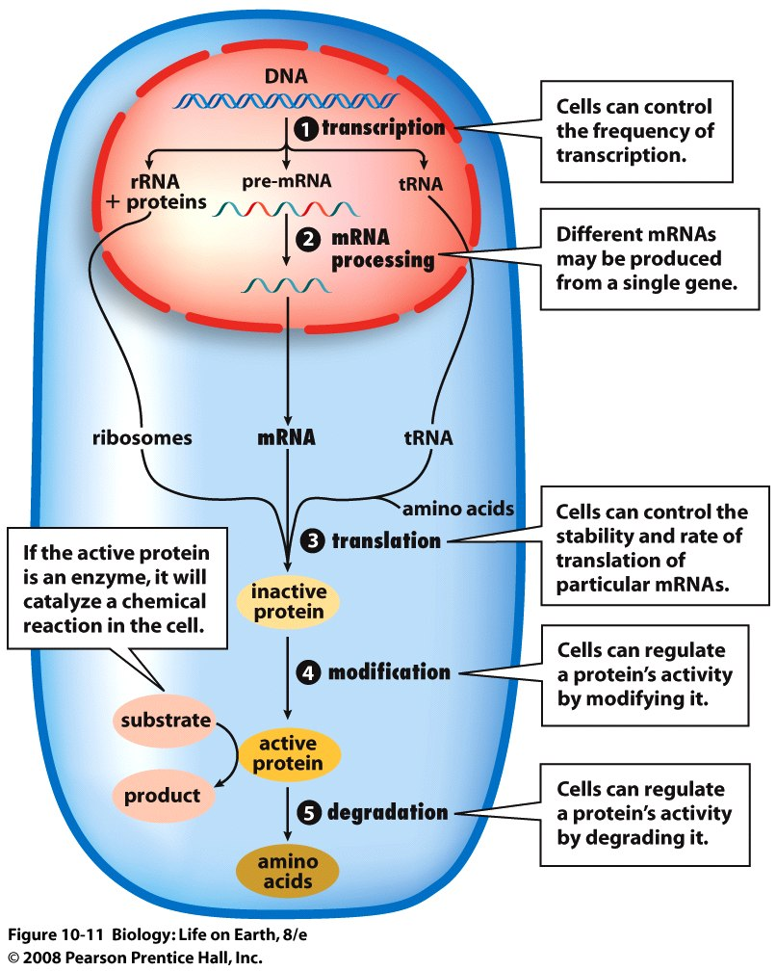
Gene Regulation in Eukaryotes
Expression of genetic information by a eukaryotic cell is a multistep process, beginning with transcription of DNA, and ending with a protein that performs a particular function

Slide 15
Gene Regulation in Eukaryotes
In eukaryotic cells, transcriptional regulation occurs on at least three levels
  The individual gene
  Regions of chromosomes
  Entire chromosomes

Slide 16
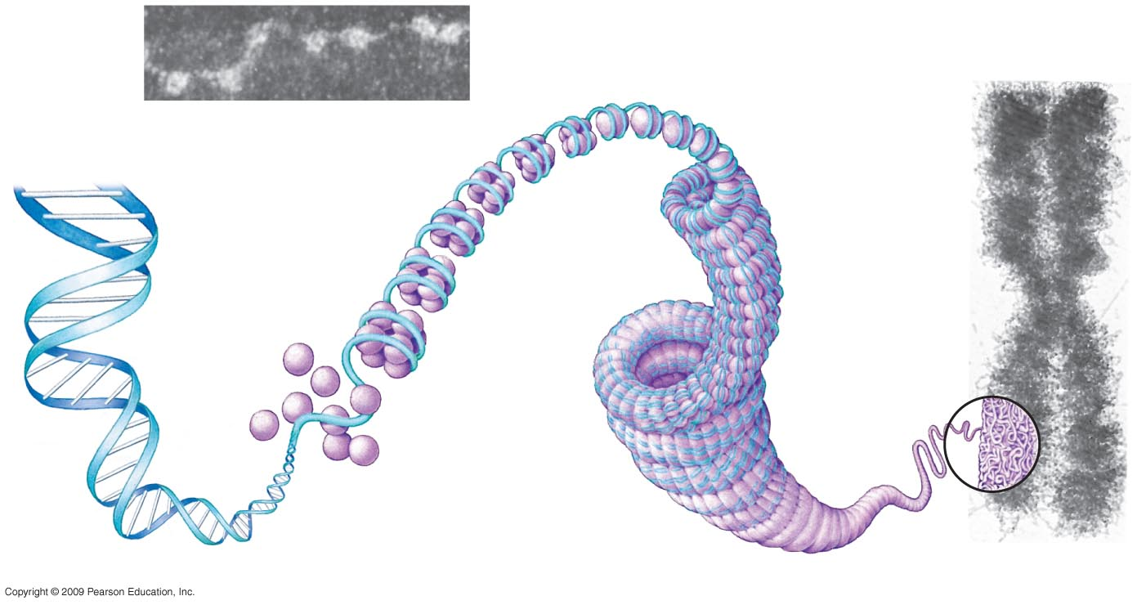
DNA packing in eukaryotic chromosomes helps regulate gene expression
0
Metaphase
chromosome
Tight helical fiber
(30-nm diameter)
DNA double helix
(2-nm diameter)
Linker
“Beads on
a string”
Nucleosome
(10-nm
diameter)
Histones
Supercoil
(300-nm diameter)
700 nm
Notes:
Figure 11.3 DNA packing in a eukaryotic chromosome.
This figure shows the increasing levels of DNA packing. The initial level of the nucleosome involves ~140 base pairs of DNA surrounding 8 molecules of histone proteins. A linker region of 40–60 nucleotides is found between nucleosomes. Histones are highly evolutionarily conserved proteins, with only two amino acid changes between histone H4 molecules in pea plants and cows. The combination of histones with DNA has long been associated with the inhibition of transcription. Histones have sites for acetylation in their amino-terminal regions that can reduce binding between positively charged lysine residues and negatively charged DNA. Histone acetylation has been correlated with increased transcriptional activity as it would allow for transient removal of the histone-protein portion of the nucleosome during transcription.

Slide 17
Complex assemblies of proteins control eukaryotic transcription
0
  Regulatory proteins that bind to control sequences
    Transcription factors promote RNA polymerase binding to the promoter
    Activator proteins bind to DNA enhancers and interact with other transcription factors
    Silencers are repressors that inhibit transcription
  Control sequences
    Promoter – The gene “switch”
    Enhancer – The “transformer” of the gene circuit
      Related genes located on different chromosomes can be controlled by similar enhancer sequences
Notes:
Enhancer sequences can be located either upstream or downstream from the promoter. They can be found in close proximity or at great distances from the promoter region. Sequences called insulators can be positioned between an enhancer and a promoter to prevent enhancer action on that promoter.
Student Misconceptions and Concerns
1. The broad concept of selective reading of the genetic code associated with differentiation and types of cellular activity can be missed when concentrating on the extensive details of regulation. Analogies, noted below in the teaching tips, can help students relate this overall selective process to their own experiences. Students already understand the selective reading of relevant chapters in textbooks and the selective referencing of software manuals to get answers to different questions. These experiences are similar in many ways to the broad processes of gene regulation.
2. The many levels of gene regulation in eukaryotic cells can be confusing and frustrating. The water pipe analogy depicted in Figure 11.9 can be a helpful reference to organize the potential sites of regulation.
Teaching Tips
1. The authors note that the selective unpackaging of chromosomes is the “course adjustment” of eukaryotic gene expression. The initiation of RNA synthesis is the fine-tuning of the regulation. If you have recently asked your students to use microscopes in lab, you might relate these degrees of adjustment to the coarse and fine control knobs of a microscope.

Slide 18
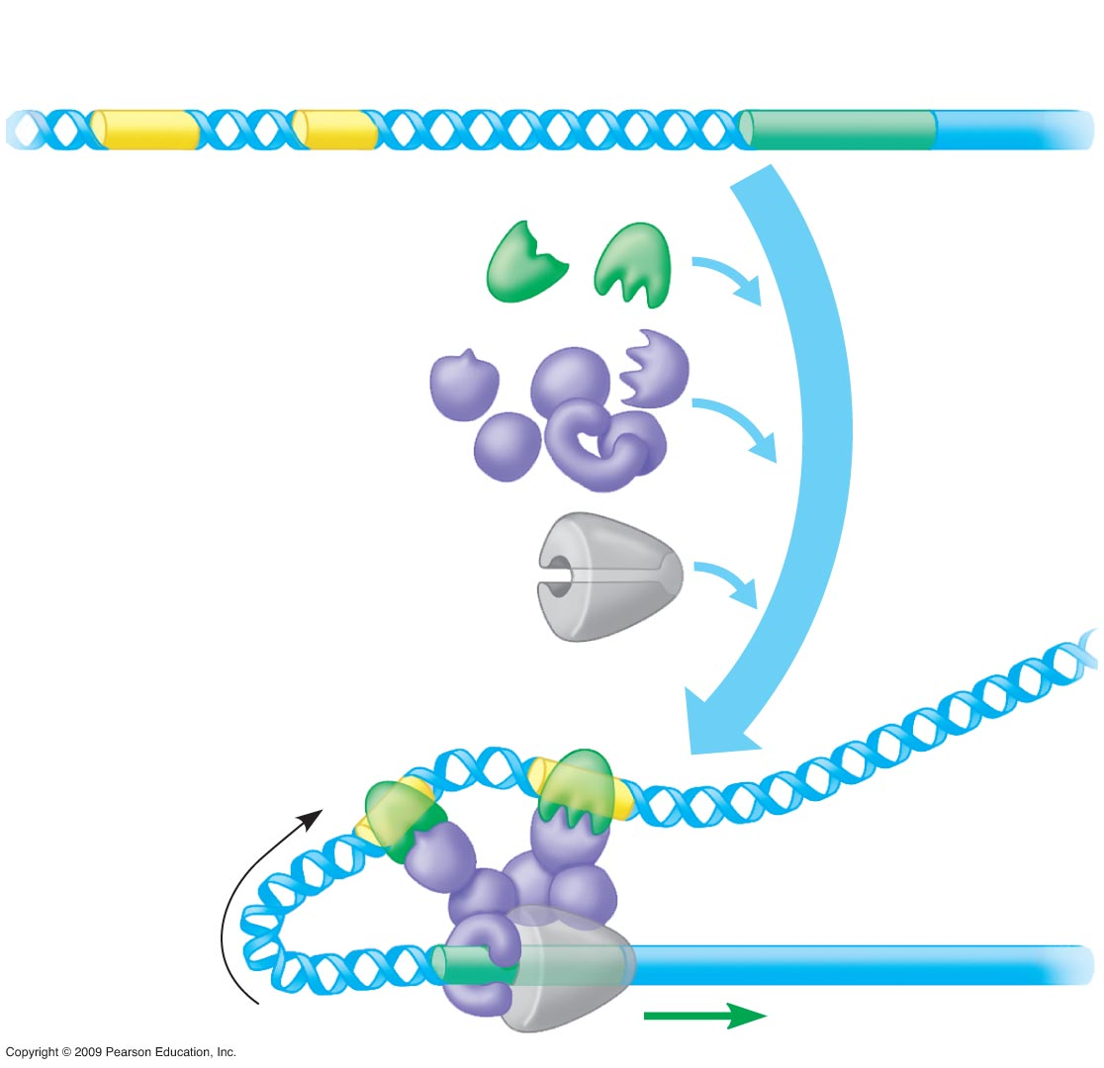
Enhancers
Promoter
0
Gene
DNA
Activator
proteins
Transcription
factors
Other
proteins
RNA polymerase
Bending
of DNA
Transcription
Notes:
Figure 11.5 A model for the turning on of a eukaryotic gene.
Sequence of events:
Activator proteins bind to an enhancer sequence.
DNA bends to bring the enhancer sequence closer to the promoter region.
Activators interact with other transcription factors that bind to the promoter.
RNA polymerase is properly positioned on the promoter and transcription is initiated.

Slide 19
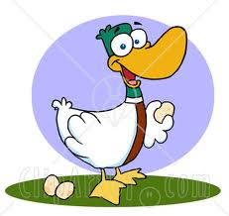
Gene Regulation in Eukaryotes
Regulatory proteins can bind to a gene’s promoter region and alter transcription
  The protein hormone estrogen causes binding of a protein to certain gene promoters like those of egg protein albumin, activating transcription
  e.g. During winter, estrogen levels are low and hence birds do not breed and lay eggs

Slide 20
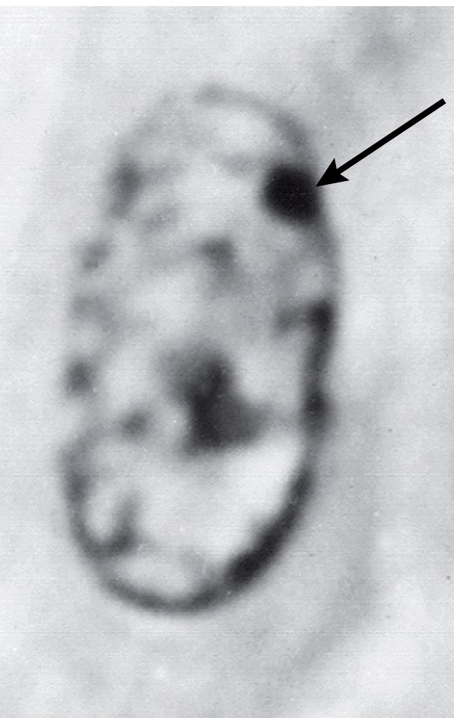
Gene Regulation in Eukaryotes
Condensed or tightly wound DNA can make genes inaccessible to RNA polymerase
Whole chromosomes can be condensed and inactivated (e.g. Barr bodies in female mammals)

Slide 21
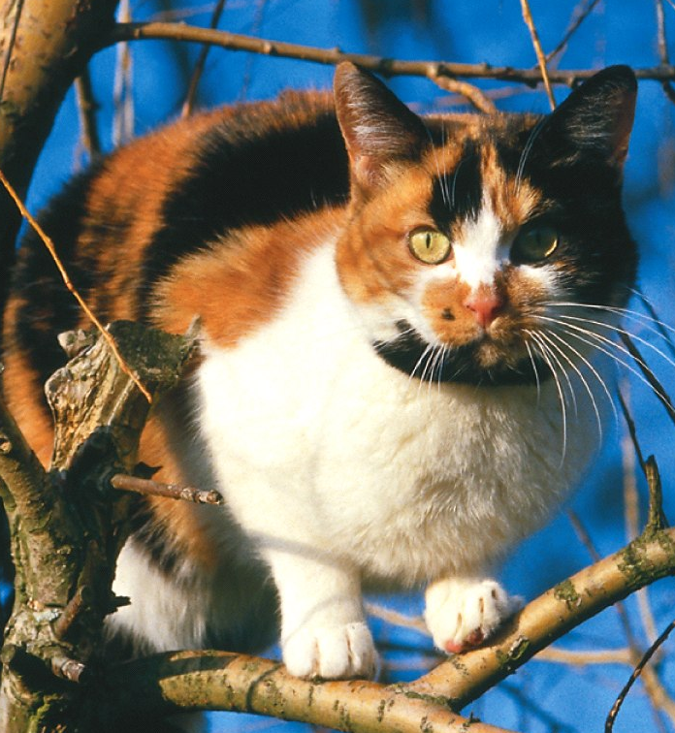
Gene Regulation – Cat Fur
The X chromosome in cats carries fur color genes
Female cat cells inactivate one of two X chromosomes in every cell (producing a Barr body)
  Different patches of skin cells in a cat inactivate different X chromosomes
  Patches of fur growing from skin cells may differ in color if fur genes on X chromosomes differ

Slide 22
Gene Regulation – RNAi
Regulatory RNA was recently discovered by Molecular Biologists
  One such process is called RNA interference or RNAi
Notes:
FIGURE 10-13 Inactivation of the X chromosome regulates gene expression
This female calico cat carries a gene for orange fur on one X chromosome and a gene for black fur on her other X chromosome. Inactivation of different X chromosomes produces the black and orange patches. The white color is due to an entirely different gene that prevents pigment formation altogether.

Slide 23
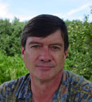


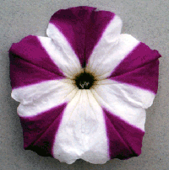
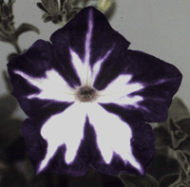
An accidental discovery
Richard Jorgensen
DNA Plant Technology Corp
1990
Co-suppression

Slide 24
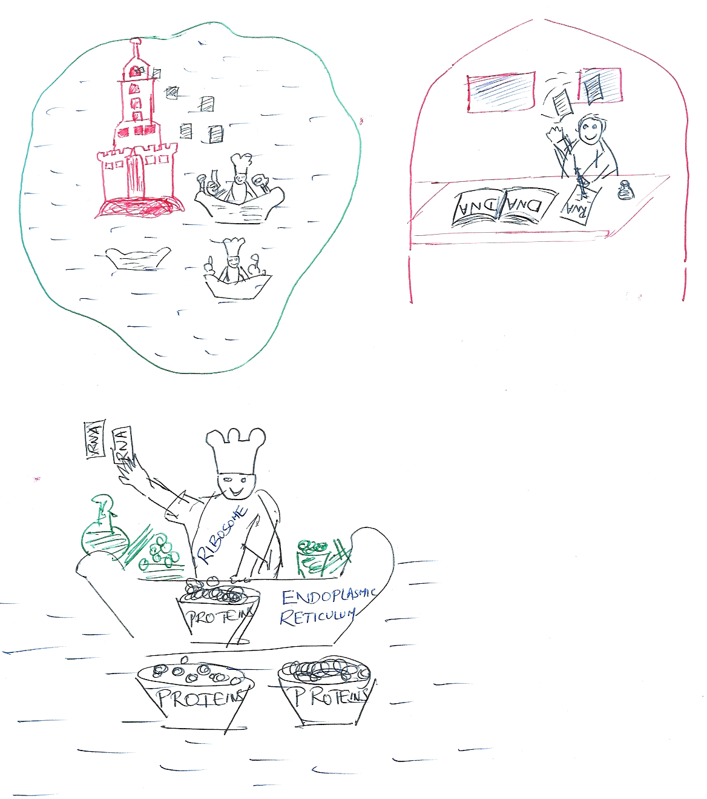
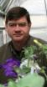
What did Rich do ?
Introduced a gene construct called chalcone synthase to make more purple pigment
Unknowingly he triggered a defense mechanism in cells

Slide 25
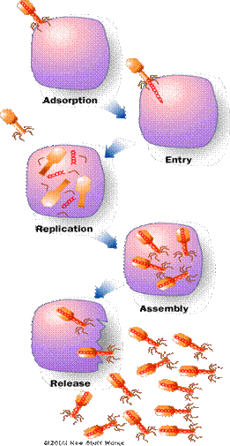
What did Rich discover (or stumble on) ?
A defense mechanism in cells against viral attack
Double stranded RNA “tricks” the protein synthesis machinery to make more viral protein
The cells defense machinery recognizes destroys the viral RNA so that no protein is made
VIGS – virus-induced gene silencing

Slide 26
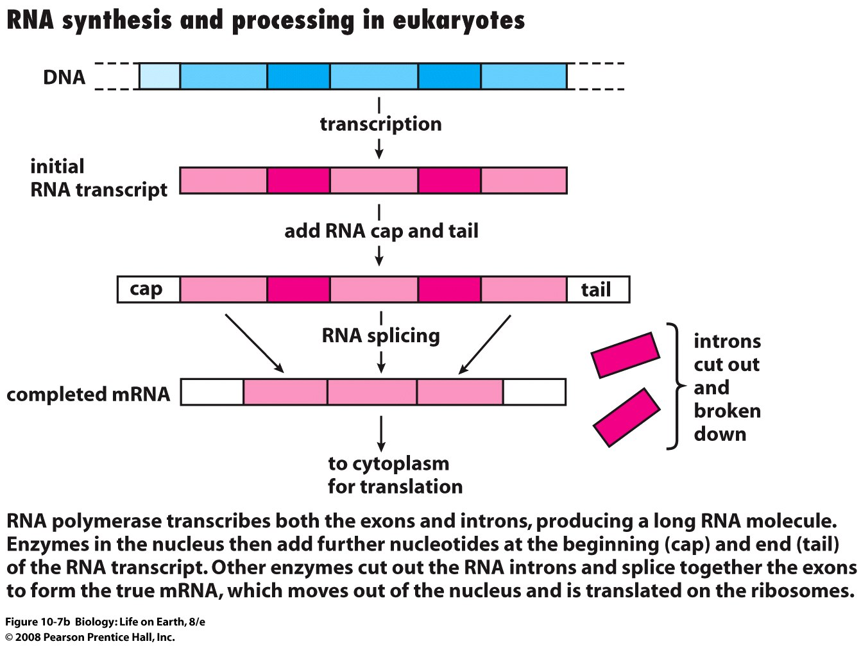
Normal RNA is single stranded !!!
Notes:
FIGURE 10-7b Messenger RNA synthesis in eukaryotic cells

Slide 27

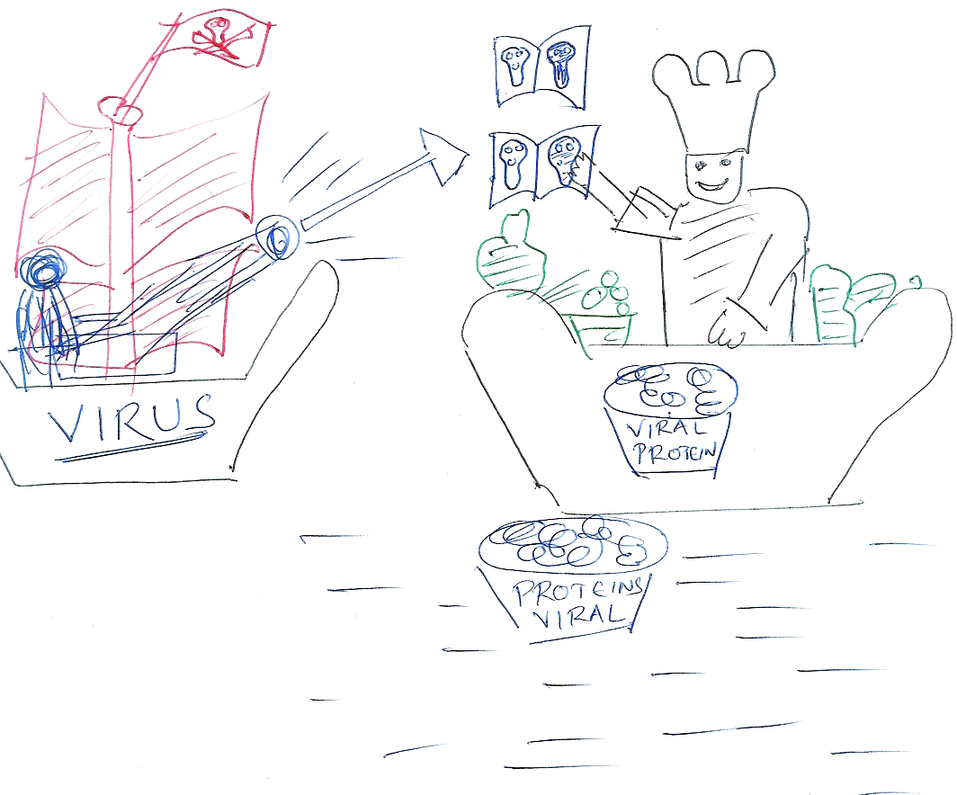

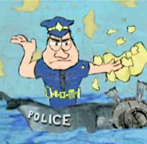
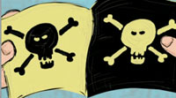
Cell’s defense system – The COP
Ribosome
Rich, by accident, discovered the COP
RNAi – RNA interference

Slide 28
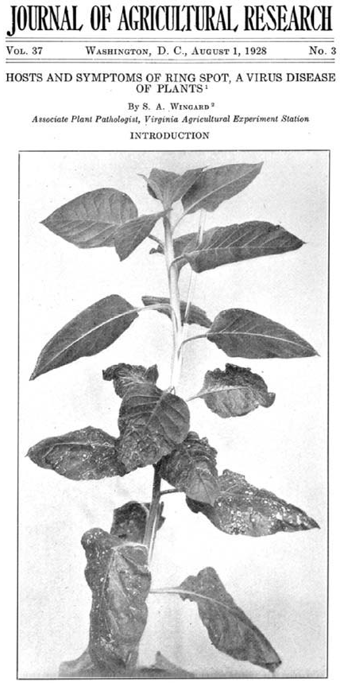
RNAi in plants - 1928
In 1928, S.A. Wingard of the Virginia Agricultural Experimental Station showed a strange occurrence of disease resistance in tobacco plants infected by tobacco ringspot virus
Initially infected leaves were necrotic, but subsequent leaves did not have disease symptoms

Slide 29
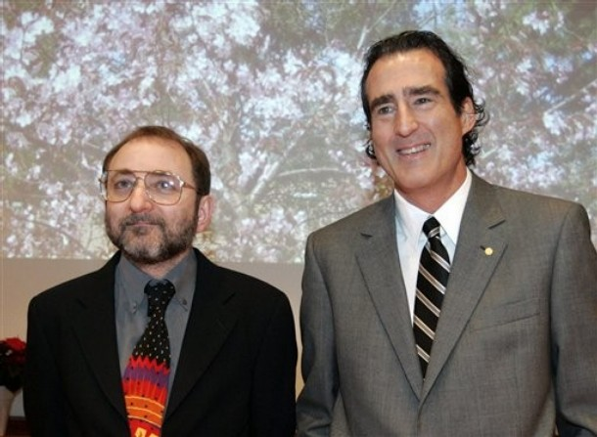
RNAi mechanism
In 1998, Fire & Mello worked out the essential steps of RNAi
They introduced synthesized SiRNA to specifically silence target genes in cells
Basically, they made “The COP” work for us
Andrew Fire & Craig Mello
Stanford and UOM
Nobel 2006

Slide 30
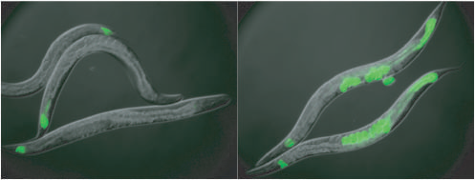

RNAi mechanism
First demonstrated in Caenorhabditis elegans (round worm)
Injected with short hairpin RNA (shRNA)

Slide 31
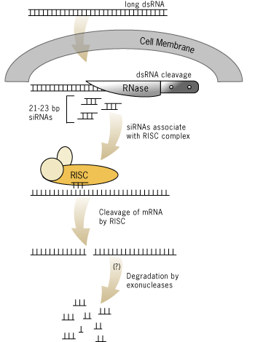
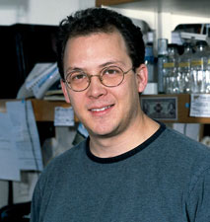
RNAi mechanism
Dicer
Short interfering RNAs
Argonaute
proteins
RNA-induced silencing complex
Gregory Hannon
Cold Spring Harbor Laboratory
1998
Guide strand

Slide 32
RNAi mechanism
Double Stranded RNA (dsRNA) triggers off the process
Dicer enzyme processes dsRNA into Short interfering RNA (SiRNA)
RNA-induced Silencing Complex (RISC) is assembled with one of the strands of SiRNA called the “guide strand” ( the left out strand is called the “passenger strand”) and the Argonaute proteins
RISC binds to and cleaves target mRNA

Slide 33
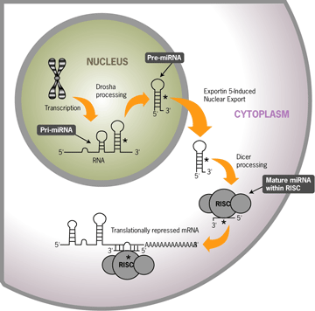
Micro RNA or MiRNA

Slide 34
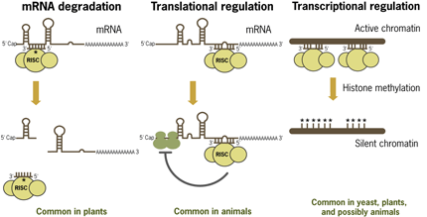
MiRNA silencing

Slide 35
An RNAi experiment
An effective RNAi trigger
  A specific dsRNA targeting a gene
An effective delivery method for the trigger
  Transfection or electroporation
A robust phenotypic assay for the RNAi effect
  E.g. GFP assay
Positive an negative controls
  Controls for both delivery and the assay

Slide 36
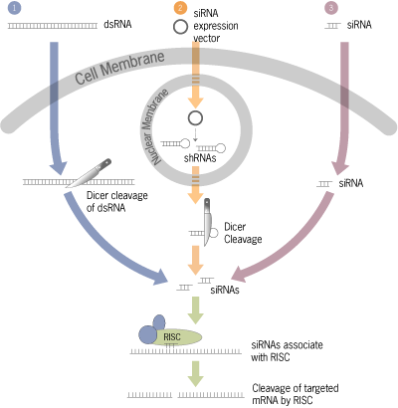
An RNAi experiment

Slide 37
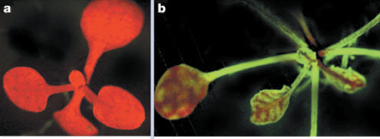
An RNAi experiment – Mobile Silencing Signal
A complete silencing of GFP spread throughout the plant
A mutated silencing signal with silencing near phloem regions

Slide 38
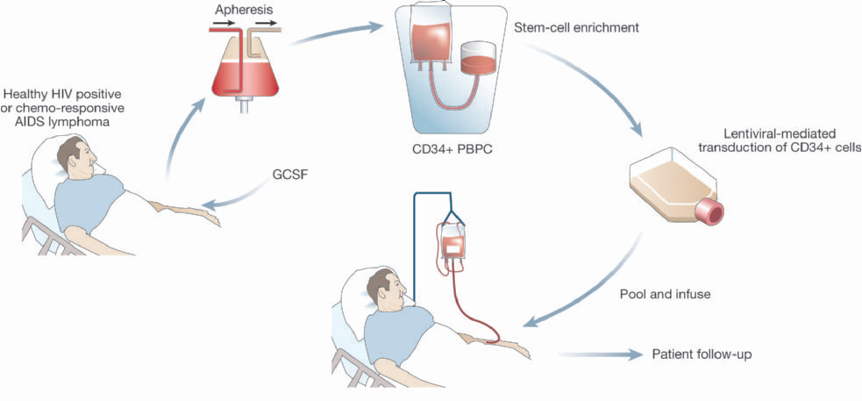
RNAi-based treatment of HIV
(PERIPHERAL BLOOD PROGENITOR CELLS)
(GRANULOCYTE COLONY STIMULATION FACTOR)

Slide 39
We finally managed the COP to work for us!

Slide 40

Male or Female ?
SRY (Sex-determining Region on Y) gene
One copy of the SRY gene even if present on XX chromosome gives male characters
SRY gene is absent in females

Slide 41
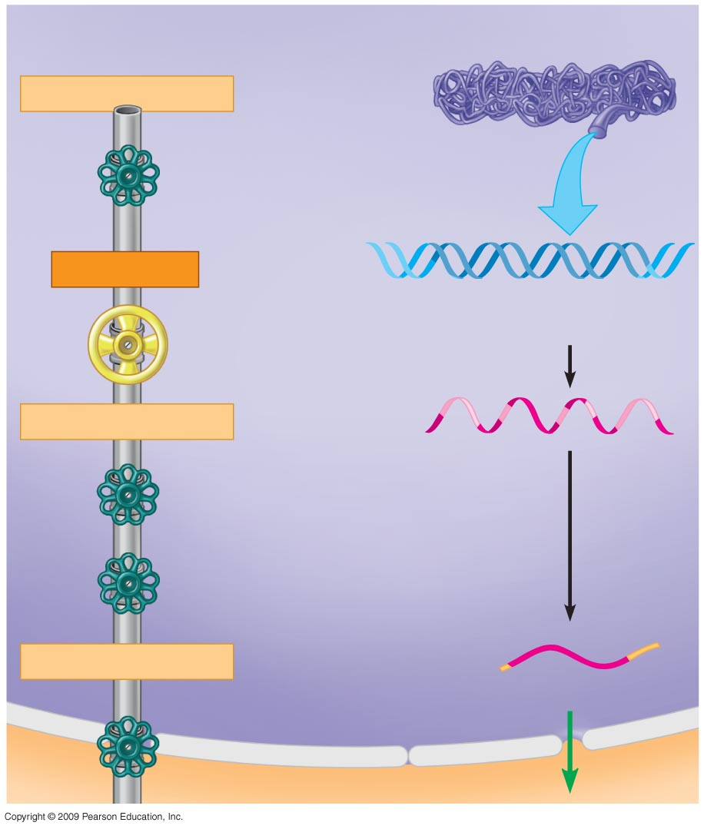
NUCLEUS
Chromosome
DNA unpacking
Other changes to DNA
Gene
Transcription
Gene
Exon
RNA transcript
Intron
Addition of cap and tail
Splicing
Tail
mRNA in nucleus
Cap
Flow through
nuclear envelope
Notes:
Figure 11.9 The gene expression “pipeline” in a eukaryotic cell.

Slide 42
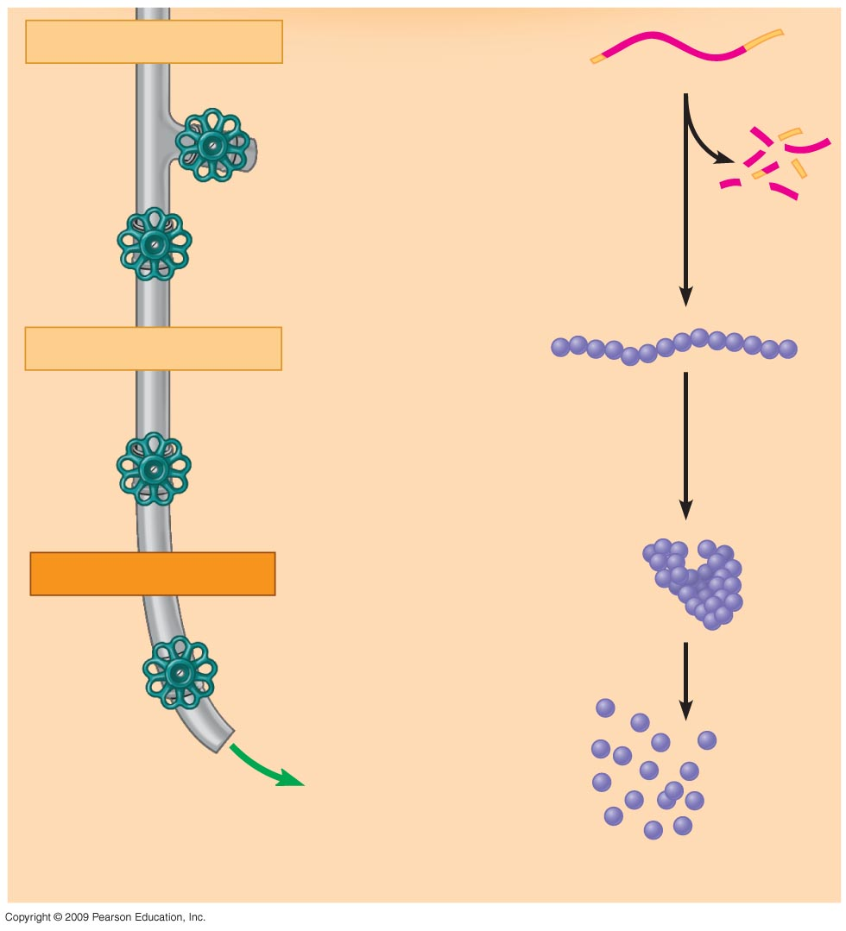
mRNA in cytoplasm
CYTOPLASM
Breakdown of mRNA
Broken-
down
mRNA
Translation
Polypeptide
Cleavage / modification /
activation
Active protein
Breakdown
of protein
Broken-
down
protein
Notes:
Figure 11.9 The gene expression “pipeline” in a eukaryotic cell.

Slide 43
Cascades of gene expression direct the development of an animal
0
  Role of gene expression in fruit fly development
    Orientation from head to tail
      Maternal mRNAs present in the egg are translated and influence formation of head to tail axis
    Segmentation of the body
      Protein products from one set of genes activate other sets of genes to divide the body into segments
    Production of adult features
      Homeotic genes are master control genes that determine the anatomy of the body, specifying structures that will develop in each segment
Notes:
The gene expression cascade in Drosophila involves maternal effect genes, gap genes, pair-rule genes, segment polarity genes, and homeotic genes. These genes act in sequential order, with products of one set of genes influencing the activity of the next set of genes, to define and organize smaller and smaller regions of the embryo. Gradients of mRNAs from the maternal effect genes are set up in the egg, and their protein products determine head to tail polarity. The maternal effect gene products influence the gap genes, which define broad sections of the embryo along the anterior-posterior axis. The gap genes influence pair-rule genes that affect the development of alternating segments. Pair-rule genes influence segment polarity genes that define segment boundaries and affect the organization of individual segments. Homeotic genes specify the fates of cells within a segment, regulating segment differentiation.
Student Misconceptions and Concerns
1. The broad concept of selective reading of the genetic code associated with differentiation and types of cellular activity can be missed when concentrating on the extensive details of regulation. Analogies, noted below in the teaching tips, can help students relate this overall selective process to their own experiences. Students already understand the selective reading of relevant chapters in textbooks and the selective referencing of software manuals to get answers to different questions. These experiences are similar in many ways to the broad processes of gene regulation.
2. The many levels of gene regulation in eukaryotic cells can be confusing and frustrating. The water pipe analogy depicted in Figure 11.9 can be a helpful reference to organize the potential sites of regulation.
Teaching Tips
1. Homeotic genes are often called master control genes. The relationship between homeotic genes and structural genes is like the relationship between a construction supervisor and the workers. Major rearrangements can result from a few simple changes in the directions for construction.

Slide 44
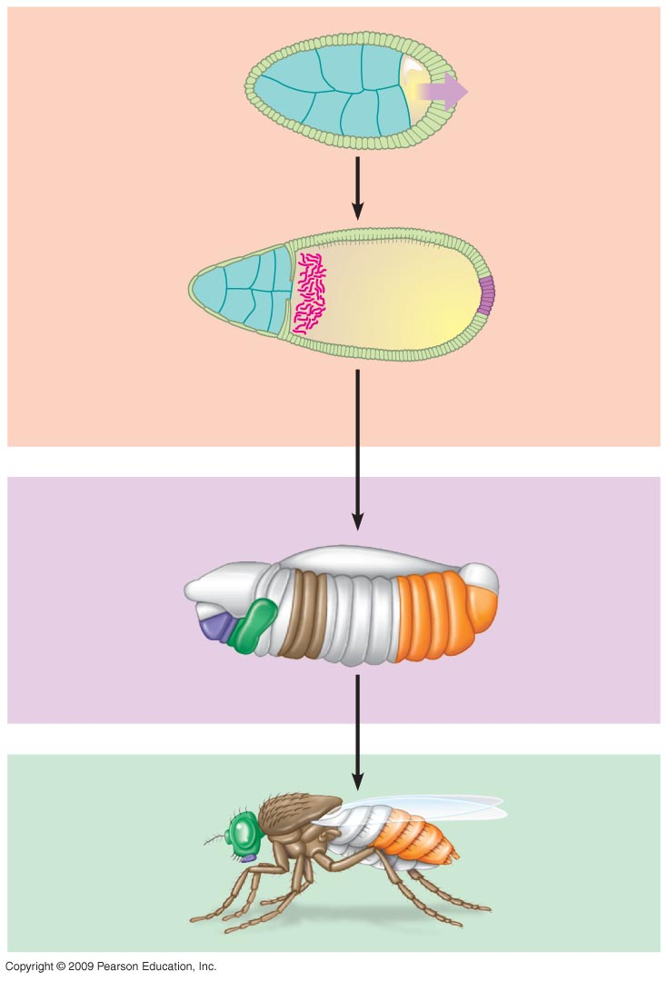
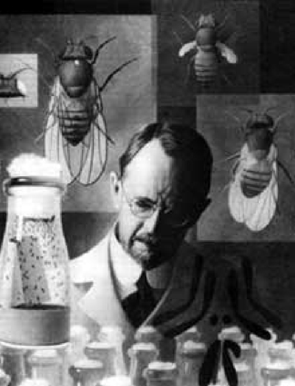
0
Egg cell
within ovarian
follicle
Egg cell
Protein
signal
Follicle cells
1
Gene expression
“Head”
mRNA
Cascades of
gene expression
2
Embryo
Body
segments
3
Gene expression
Thomas Hunt Morgan
American Geneticist
Lexington, Kentucky
Adult fly
4
Notes:
Figure 11.10B Key steps in the early development of head-tail polarity in a fruit fly.
This figure shows the progressive stages of gene expression. The action of maternal effect genes are illustrated in the top panel. Concentration of the mRNA for the gene bicoid, or “head” mRNA, determines the anterior end of the fly. The middle panel combines the effects of gap genes, pair-rule genes, and segment polarity genes. The bottom panel shows the action of homeotic genes.

Slide 45
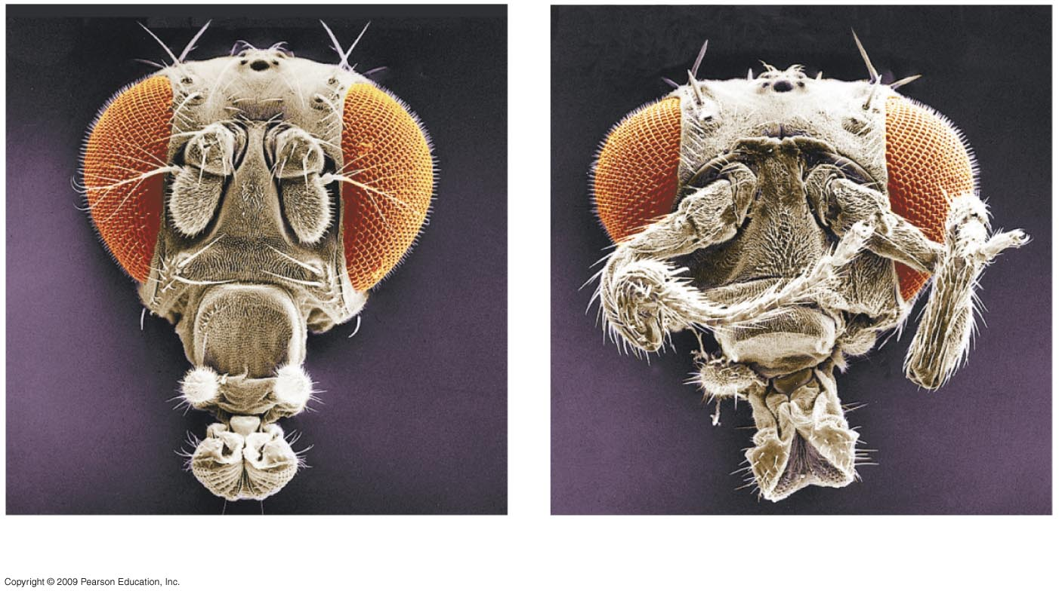
Gene Cascades can be controlled
0
Eye
Antenna
Leg
Head of a normal fruit fly
Head of a developmental mutant
Notes:
Figure 11.10A A mutant fruit fly with legs coming out of its head, compared with a normal fruit fly.
The fly on the right has a mutation in one of the homeotic genes, Antennapedia, causing the formation of legs where the antennae should be.

Slide 46
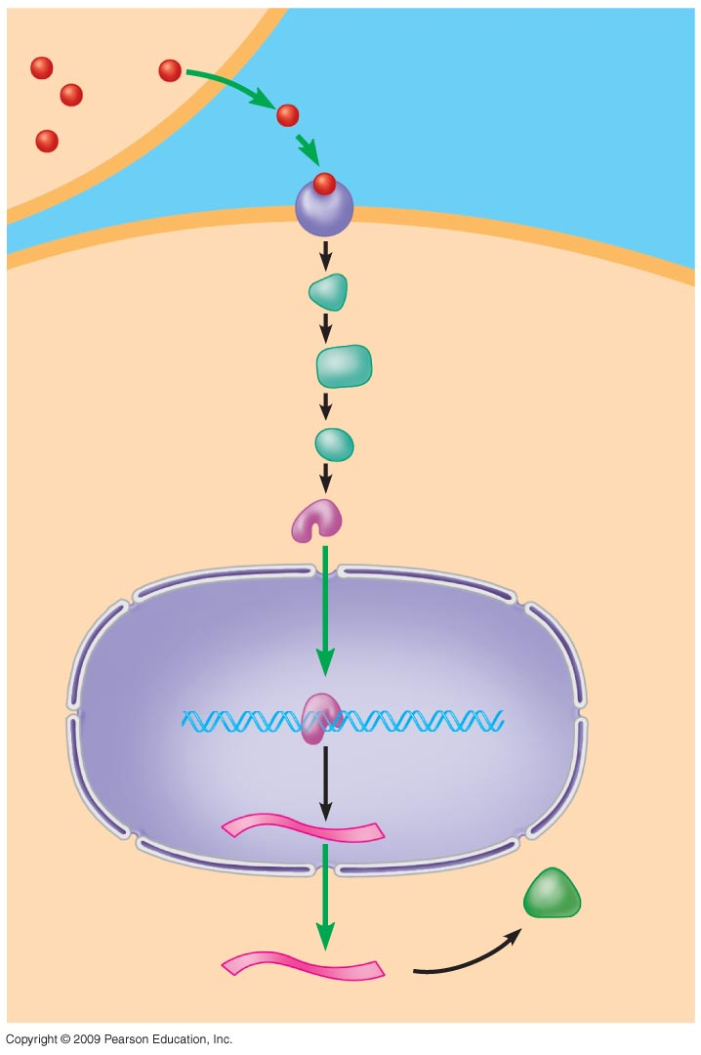
0
  Signal transduction pathway is a series of molecular changes that converts a signal at the cell’s surface to a response within the cell
    Signal molecule is released by a signaling cell
    Signal molecule binds to a receptor on the surface of a target cell
Signaling cell
Signaling
molecule
1
Plasma
membrane
2
Receptor
protein
3
Target cell
Relay
proteins
Transcription
factor
(activated)
4
Nucleus
DNA
5
Transcription
mRNA
New
protein
6
Translation
Notes:
An increase in cell division is one example of a cellular response at the end of a signal transduction pathway. Epidermal growth factor (EGF) is a signal molecule that leads to an increase in the activity of transcription factor NF-kappaB. NF-kappaB increases transcription of the gene for cyclin D1. Cyclin D1 promotes progress through the cell cycle at the G1 → S transition, through deactivation of retinoblastoma (Rb) protein. This pathway leads to the uncontrolled growth of estrogen-receptor negative (ER-negative) breast cancer cells. ER-negative cells have higher levels of EGF receptors and thus produce elevated levels of NF-kappaB and cyclin D1. The possibility of inhibiting the action of NF-kappaB as a cancer therapy is being pursued.
Student Misconceptions and Concerns
1. The broad concept of selective reading of the genetic code associated with differentiation and types of cellular activity can be missed when concentrating on the extensive details of regulation. Analogies, noted below in the teaching tips, can help students relate this overall selective process to their own experiences. Students already understand the selective reading of relevant chapters in textbooks and the selective referencing of software manuals to get answers to different questions. These experiences are similar in many ways to the broad processes of gene regulation.
2. The many levels of gene regulation in eukaryotic cells can be confusing and frustrating. The water pipe analogy depicted in Figure 11.9 can be a helpful reference to organize the potential sites of regulation.
Teaching Tips
1. The action of an extracellular signal reaching a cell’s surface in a signal transduction pathway is like pushing the doorbell at a home. The signal is converted to another form (pushing a button rings a bell), and activities change within the house as someone comes to answer the door.
2. Some of the stages of a signal transduction pathway can be compared to a human reaction. Consider someone calling your name. (1) Reception—The sound waves of someone’s voice hitting and changing the shape of your eardrum. (2) Transduction—Your ear converts sound waves to nerve impulses and sends a signal to your brain that your name has been called. (3) Response—You look around to see who is calling.

